Slide 1



WELCOME TO YEAR 6
Helping Everyone Shine Their Light

Slide 2
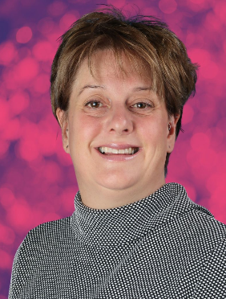
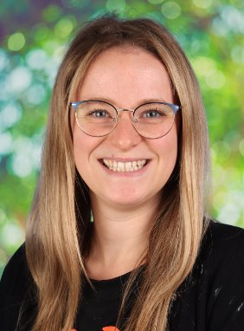
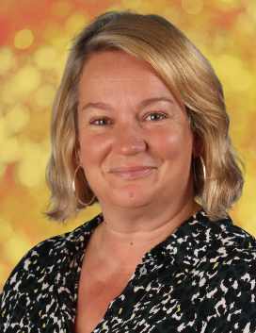
CEDAR CLASS TEACHER
Mrs Gibson
SYCAMORE CLASS TEACHERS
Mrs Martin
Mon
Mrs Sandford
Tues- Fri

Slide 3
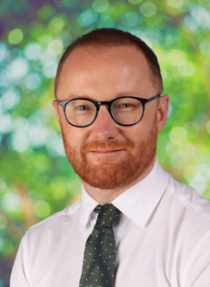
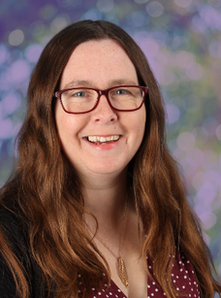
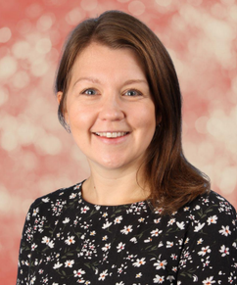
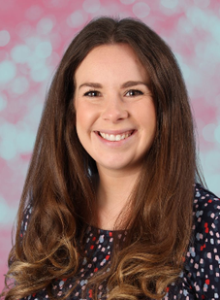
SAFEGUARDING TEAM:
Mr Crawley
Mrs Cork
Mrs Brennen
Mrs Howells

Slide 4
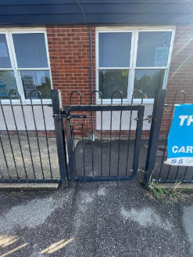
DROP OFF & PICK UP
  Arrival: 8:45am (gates close at 8:55am)
  Departure: 3:15pm
  Middle gate- both classes use this gate.
  It is really helpful if you try and stand in the same location at the end of each day so we can easily find you and send your child over. A wave is also very welcomed!
  Please inform the office via email if your child has permission to walk home.
  If your child has a mobile phone, it must be switched off before coming into class. It will be stored safely in school and handed back to your child at the end of the day. It can only be switched on after leaving the school site.

Slide 5
UNIFORM
  Children should come to school wearing their P.E. kit on P.E. days but should wear their school uniform on all other days.
  Children should not wear jewellery other than stud earrings which must be removed for P.E. lessons. If a child is not able to remove their own stud earrings for P.E. then they should not wear them to school that day.
  Children should not wear make-up (including nail polish and hair dye) or transfer tattoos to school unless specifically stated for special events.
  Please see the school website for further details.

Slide 6
UNIFORM
  Hair must be worn tied up if shoulder length or longer.
  Children should wear plain black trainers or plain black school shoes for daily school life, including PE.
  Children should always come to school wearing appropriate clothing for the weather.
  Fitbits / other watches can be worn but please ensure there they are not connected to the internet.
  Please inform the office via email if your child has permission to walk home.
  PLEASE MAKE SURE EVERYTHING IS NAMED!!

Slide 7
NATIONAL CURRICULUM
We adopt a theme-based approach to make the learning creative, fun and easier for the children to make links in their learning.
You can find out more about the curriculum content for each year group on our school website:
https://www.heathlands.essex.sch.uk/page/?title=Our+Learning&pid=8

Slide 8
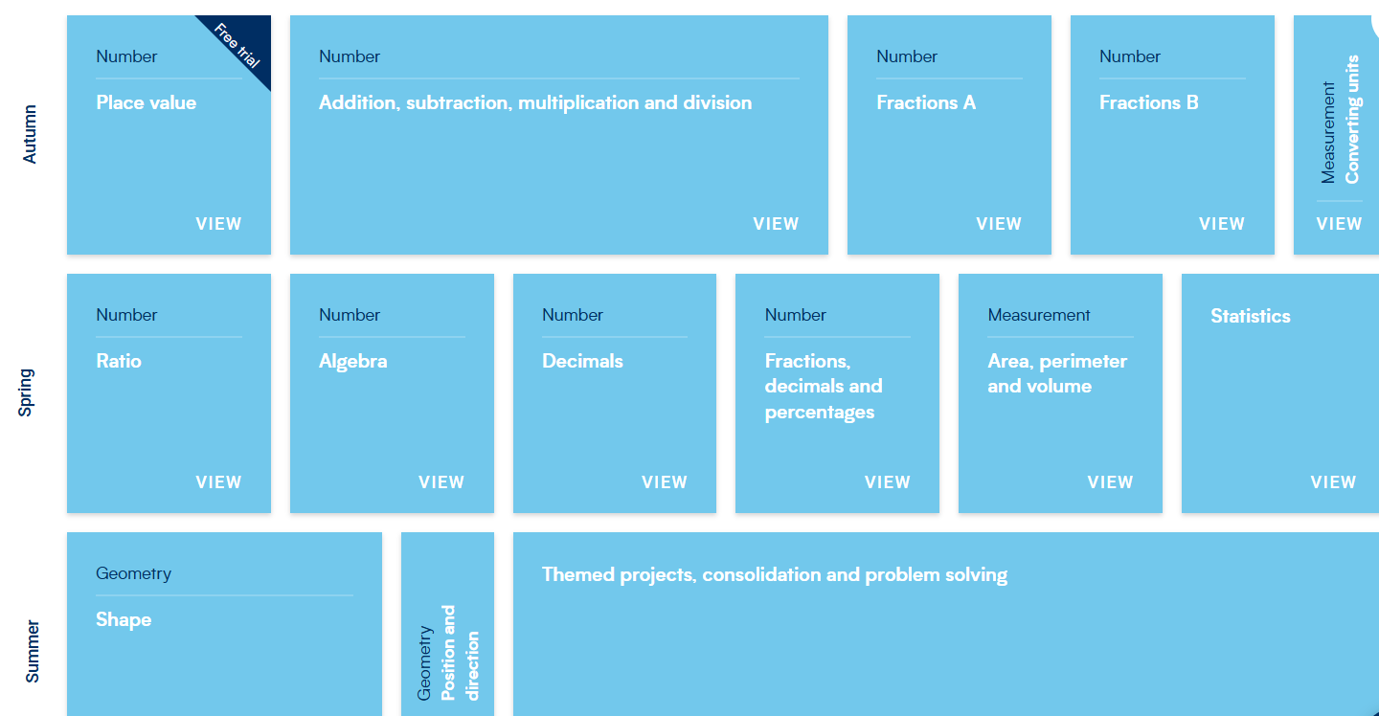
MATHS:

Slide 9
READING
  Children should read an age-appropriate book at least 5 times each week at home.
  10 - 15 minutes, per day.
  Pupils will have the opportunity to visit the library and choose a book of their choice
  A school adult will also hear your child read in school at least once a half term.

Slide 10
OUR THEMES
Autumn – Breaking News
Spring – The Maya
Summer – Groovy Greeks

Slide 11
TRIPS AND VISITORS
Autumn
Trip: PGL residential - Monday 5th - Friday 9th October
Spring
Mexicolore (Mayan expert) - Friday 26th February
approx cost- £11
Summer
Theatre Trip - May 2027 (approx cost £69)
Crucial Crew - June 2027(approx cost £7)

Slide 12
PGL RESIDENTIAL
https://www.pgl.co.uk/Files/DocumentManagerDocuments/Web/Kit%20Lists/PGL-Kit-List-UK.pdf
PGL, Bawdsey Manor.
Final payment to be paid by 1st September.
Disposable lunch bag on the first day.
Coach leaves school at 9:30am.
Returns on Friday at approximately 3pm.
Please don't send any electronics (including phones/ smart watches).
Other than disco clothes, it's old, warm and comfortable clothes for the week.
Medium sized case/bag to help storage in rooms as well as them needing to carry it up two flights of stairs.
Bedding needed: sleeping bag or duvet and a pillow.
Bedsheet provided by PGL.
Spending money- up to £10 for the shop.

Slide 13
HOME LEARNING
Spelling – Half-termly tests from the Year 5/6 word lists
Maths and English- Pupils will be given a login for LBQ (Learning By Questions). Each week children will be set homework for Maths and English which is to be completed online. Homework is due in on a Thursday.

Slide 14

RELATIONSHIPS AND BEHAVIOUR
Our Behaviour and Relationships Policy is based on this simple code of conduct where we promote ‘Being Safe, Being Kind, Being Respectful’ every day at Heathlands.

Slide 15

RELATIONSHIPS AND BEHAVIOUR
  Class marbles awarded for the class – this could be for anything from excellent lining up and great manners to a wonderful maths lesson or seeing brilliant teamwork.
  Any child who goes above and beyond in demonstrating our Core Values, embracing our Visible Learning ethos, or consistently making the right choices can be awarded a Celebration Certificate by any adult in school, at any time. These certificates will be displayed in classrooms and sent home at the end of each week.

Slide 16
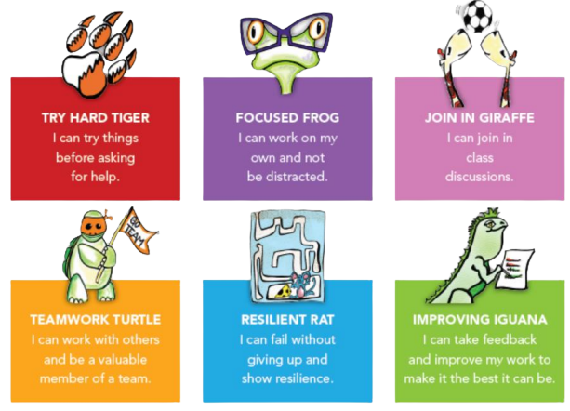
VISIBLE LEARNING

Slide 17
MAKING CONTACT
  Class Dojo – we will use Class Dojo for communication. Teachers will check and reply to messages between the hours of 8:00am and 5:00pm only. However, as teachers are teaching during the day they may not see messages immediately.
  Alternatively, please make an appointment with the school office and we will try to speak to you as soon as possible or catch us on the gate.
  Should you need to contact the school office please use: admin@heathlands.essex.sch.uk
  If your child is going home with someone other than you, please let us know (in person or via the office). If this is a regular arrangement please let the office know, so they can amend the pick-up sheet.
  If your child is absent for any medical reason, please let the office know as the first port of call.
  All forms of communication between home and school should be in line with our core values of trust, respect, enjoyment, courage and kindness.
  Please do not put personal notes in your child’s reading diary as other adults may see this and we do not check the diaries every day.

Slide 18
DATES FOR YOUR DIARY
  Parent consultations:
    20ᵗʰ and 22ⁿᵈ October 2026
    9ᵗʰ and 11ᵗʰ February 2027
  Harvest Service: 28ᵗʰ September 2026
  Fireworks: 7ᵗʰ November 2026
  Christmas Service: 1ˢᵗ December 2026
  Easter Service: 24ᵗʰ March 2027
  Sats week-Monday 10th- Thursday 13th May 2027
  Sports Day: 16ᵗʰ June 2027

