Slide 1



WELCOME TO YEAR 5
Helping Everyone Shine Their Light

Slide 2

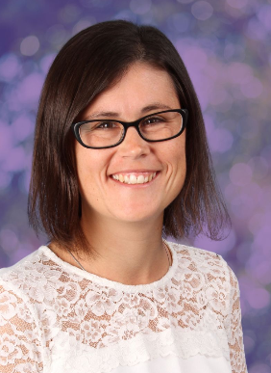
BONSAI CLASS TEACHER
Mr Hassard
CHERRY CLASS TEACHER
Mrs Hodgson

Slide 3
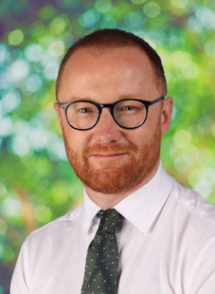
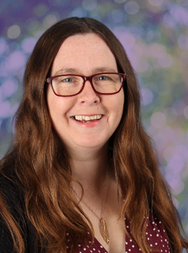
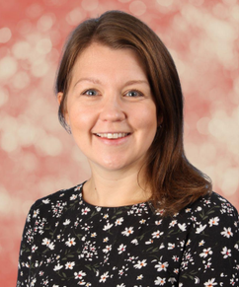
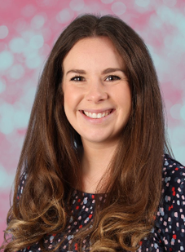
SAFEGUARDING TEAM:
Mr Crawley
Mrs Cork
Mrs Brennen
Mrs Howells

Slide 4
DROP OFF & PICK UP
  Arrival: 8:45am (gates close at 8:55am)
  Departure: 3:15pm
  Bonsai
  Drop off: middle gate
  Pick up: middle gate
  Cherry
  Drop off: left hand side gate
  Pick up: middle gate

Slide 5
UNIFORM
  Children should come to school wearing their P.E. kit on P.E. days and should wear their school uniform on all other days.
  Children should not wear jewellery other than stud earrings which must be removed for P.E. lessons. If a child is not able to remove their own stud earrings for P.E. then they should not wear them to school that day.
  Children should not wear make-up (including nail polish and hair dye) or transfer tattoos to school unless specifically stated for special events.
  Please see the school website for further details.

Slide 6
UNIFORM
  Hair must be worn tied up if shoulder length or longer.
  Children should wear plain black trainers or plain black school shoes for daily school life, including PE.
  Children should always come to school wearing appropriate clothing for the weather.
  Fitbits / other watches can be worn but please ensure there they are not connected to the internet.
  Please inform the office via email if your child has permission to walk home.
  If your child has a mobile phone, it must be switched off before coming into class. It will be stored safely in school and handed back to your child at the end of the day. It can only be switched on after leaving the school site.

Slide 7
NATIONAL CURRICULUM
We adopt a theme-based approach to make the learning creative, fun and easier for the children to make links in their learning.
You can find out more about the curriculum content for each year group on our school website:
https://www.heathlands.essex.sch.uk/page/?title=Our+Learning&pid=8

Slide 8
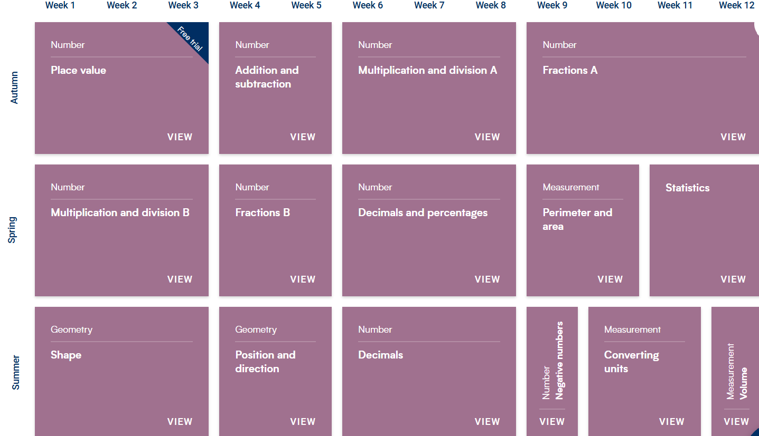
MATHS:

Slide 9
READING
  Children should read at least 5 times each week at home, 5 - 10 minutes, every night.
  Ask questions about the story, for example, “Why do you think he did that?”.
  A school adult will also hear your child read in school throughout each term.

Slide 10
OUR THEMES
Autumn – WW2
Spring – The Art of Drawing
Summer – Journeys

Slide 11
TRIPS AND VISITORS
Autumn
Trip: IWM Duxford (WW2)
Spring
Wonder Dome (Science)
Summer
Local visit: Village walk
Approximate costs for both visits £23

Slide 12
HOME LEARNING
Reading – Regular reading to an adult at home, at least 5 times each week, using a circled H to show a ‘home read’ in diaries
Spelling – We will send home some optional activities linked to the spelling of the tricky words and common exception words. There is no obligation to complete all of these, but any support you can provide with the learning of these words will be gratefully received.
Maths – We will be using a programme called Doodle Learning.
Pupils will need to log on (via the Doodle Maths app or a web browser) and ensure they reach the ‘green’ zone each week. More information will be shared after the holidays.

Slide 13

RELATIONSHIPS AND BEHAVIOUR
Our Behaviour and Relationships Policy is based on this simple code of conduct where we promote ‘Being Safe, Being Kind, Being Respectful’ every day at Heathlands.

Slide 14

RELATIONSHIPS AND BEHAVIOUR
  Class marbles awarded for the class – this could be for anything from excellent lining up and great manners to a wonderful maths lesson or seeing brilliant teamwork.
  Any child who goes above and beyond in demonstrating our Core Values, embracing our Visible Learning ethos, or consistently making the right choices can be awarded a Celebration Certificate by any adult in school, at any time. These certificates will be displayed in classrooms and sent home at the end of each week.

Slide 15

VISIBLE LEARNING

Slide 16
MAKING CONTACT
  Class Dojo – we will use Class Dojo for communication. Teachers will check and reply to messages between the hours of 8:00am and 5:00pm only. However, as teachers are teaching during the day they may not see messages immediately.
  Alternatively, please make an appointment with the school office and we will try to speak to you as soon as possible or catch us on the gate.
  Should you need to contact the school office please use: admin@heathlands.essex.sch.uk
  If your child is going home with someone other than you, please let us know (in person or via the office). If this is a regular arrangement please let the office know, so they can amend the pick-up sheet.
  If your child is absent for any medical reason, please let the office know as the first port of call.
  All forms of communication between home and school should be in line with our core values of trust, respect, enjoyment, courage and kindness.

Slide 17
DATES FOR YOUR DIARY
  Parent consultations:
    20ᵗʰ and 22ⁿᵈ October 2026
    9ᵗʰ and 11ᵗʰ February 2027
  Harvest Service: 28ᵗʰ September 2026
  Fireworks: 7ᵗʰ November 2026
  Christmas Service: 1ˢᵗ December 2026
  Easter Service: 24ᵗʰ March 2027
  Sports Day: 16ᵗʰ June 2027

