Slide 1



WELCOME TO YEAR 4
Helping Everyone Shine Their Light

Slide 2
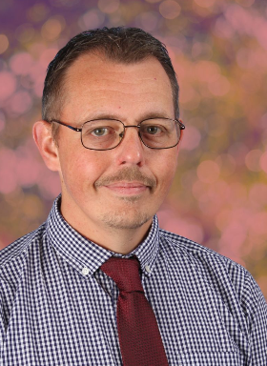
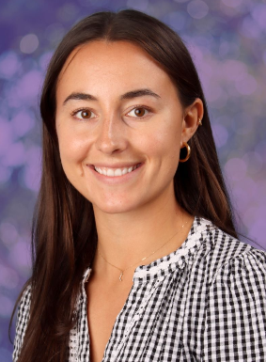
LIME CLASS TEACHER
Mr Turver- Lower Junior Phase Lead
HORNBEAM CLASS TEACHERS
Miss Philpott

Slide 3
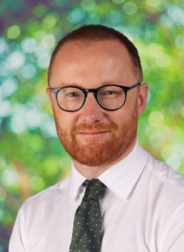
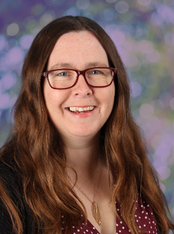
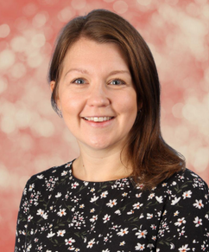
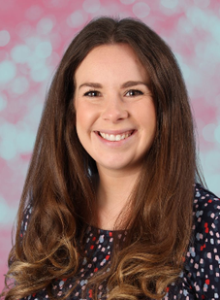
SAFEGUARDING TEAM:
Mr Crawley
Mrs Cork
Mrs Brennen
Mrs Howells

Slide 4
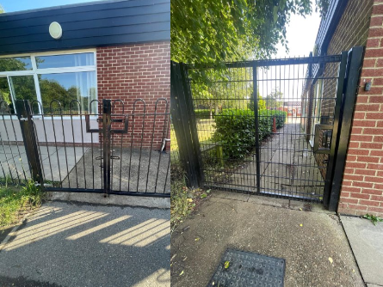
DROP OFF & PICK UP
  Arrival: 8:45am (gates close at 8:55am)
  Departure: 3:15pm
  Side Gate (closest to the playground)
  Lower KS2 use this gate.
  It is really helpful if you try and stand in the same location at the end of each day so we can easily find you and send your child over. A wave is also very welcomed!

Slide 5
UNIFORM
  Children should come to school wearing their P.E. kit on P.E. days but should wear their school uniform on all other days.
  Children should not wear jewellery other than stud earrings which must be removed for P.E. lessons. If a child is not able to remove their own stud earrings for P.E. then they should not wear them to school that day.
  Children should not wear make-up (including nail polish and hair dye) or transfer tattoos to school unless specifically stated for special events.
  Please see the school website for further details.

Slide 6
UNIFORM
  Hair must be worn tied up if shoulder length or longer.
  Children should wear plain black trainers or plain black school shoes for daily school life, including PE.
  Children should always come to school wearing appropriate clothing for the weather.
  Fitbits / other watches can be worn but please ensure there are no alarms set.
  Year 4 children can bring their own pencil case to school, with stationary (black biro style pen only for writing in books).
  PLEASE MAKE SURE EVERYTHING IS NAMED!!

Slide 7
NATIONAL CURRICULUM
We adopt a theme-based approach to make the learning creative, fun and easier for the children to make links in their learning.
You can find out more about the curriculum content for each year group on our school website:
https://www.heathlands.essex.sch.uk/page/?title=Our+Learning&pid=8

Slide 8
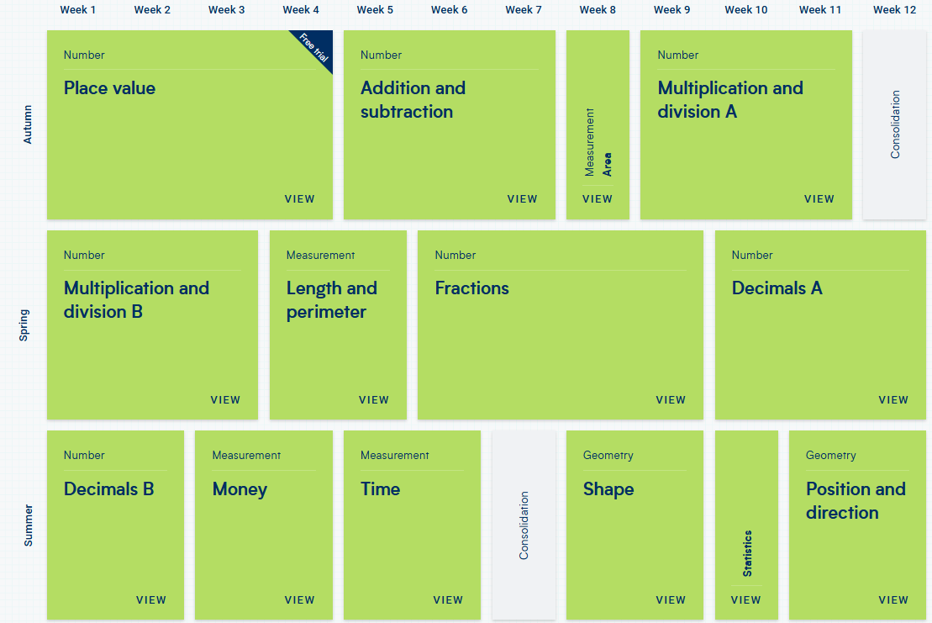
MATHS:

Slide 9
TIMES TABLES
  Towards the end of Year 4, the children will complete a times table check, which compares data nationally.
  The aim of the check is to add a focus to times tables as they are essential to mathematical fluency as the children get older and start to use more complex calculations.
  The target by the end of Year 4, is to know all the times table facts up to 12 x 12.
  In the times table check, the children will use an iPad to record their answers and will be given 25 randomly generated questions and have 6 seconds per question to record their answer.
  To help prepare for this, there will be a daily times table focus, Times Table Rock Star challenges and taught lessons.
  Please support at home as much as you can.

Slide 10
READING
  Children are encouraged to choose books from the library with more independence.
  We will have weekly whole class library sessions, to support selection and explore different genres and texts.
  Children will be heard by the class teacher once a half term.
  Reading for pleasure is so important and a continued focus throughout the school. Please continue to prioritise reading with your children daily.
  Suggestions for comprehension questions:
  How does the character feel?
  What proof supports your idea?
  Can you predict what will happen next?
  How does this compare with another book you have read?
  What does this word mean?

Slide 11
OUR THEMES
Autumn – Rotten Romans and Crazy celts
Spring – Mysteries of the Anglo-Saxons
Summer – West Bergholt and beyond

Slide 12
TRIPS AND VISITORS
Autumn
Trip: Colchester Castle Visit. Approx. £15
Spring
Local visit around West Bergholt
Summer
Trip: Bluebell Woods
Trip: Mersea Outdoor Adventure day trip. Approx. £70

Slide 13
HOME LEARNING
Reading – Regular reading to an adult at home.
Spelling – We will send home some optional activities linked to the spelling of the tricky words and common exception words. There is no obligation to complete all of these, but any support you can provide with the learning of these words will be gratefully received.
Maths – We will send home a login for Times Table Rockstars and Purple Mash. Both of these websites have lots of fun activities for your child to complete.
Theme – There will be optional half termly learning challenges linked to the subjects we are teaching in school. These can be shared on Class Dojo.

Slide 14

RELATIONSHIPS AND BEHAVIOUR
Our Behaviour and Relationships Policy is based on this simple code of conduct where we promote ‘Being Safe, Being Kind, Being Respectful’ every day at Heathlands.

Slide 15

RELATIONSHIPS AND BEHAVIOUR
  Class marbles awarded for the class – this could be for anything from excellent lining up and great manners to a wonderful maths lesson or seeing brilliant teamwork.
  Any child who goes above and beyond in demonstrating our Core Values, embracing our Visible Learning ethos, or consistently making the right choices can be awarded a Celebration Certificate by any adult in school, at any time. These certificates will be displayed in classrooms and sent home at the end of each week.

Slide 16
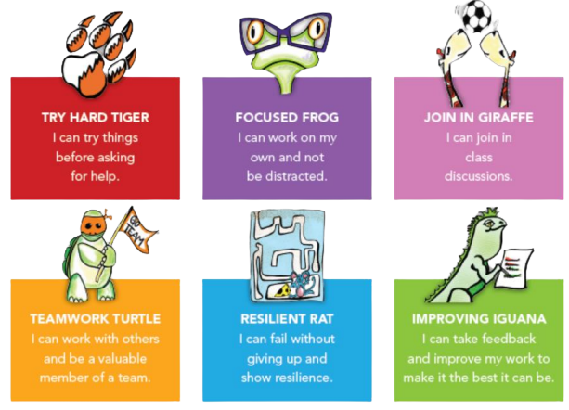
VISIBLE LEARNING

Slide 17
DAILY LIFE IN YEAR 4
  Small rucksacks with pencil case, jumper, packed lunches (optional) and reading books.
  Please name all clothes.
  Suitable clothes for outdoors: coat, gloves, sunhat, named sun cream, etc.
  A named water bottle
  Please ensure children come to school in PE kit on PE days (these will be shared each term) – this may be outside so please ensure they have enough layers to keep warm!
  Snacks: We are a healthy school and the children are provided with a fruit selection for their breaktime snack. We encourage all children to have this but understand that some children may not like what’s on offer. As a result, they can bring in their own snack but please ensure it is healthy and nut free.
  Tasty Tuck: Tuesdays and Fridays. 60p per item or £1 snack and a drink

Slide 18
MAKING CONTACT
  Class Dojo – we will use Class Dojo for communication. Teachers will check and reply to messages between the hours of 8:00am and 5:00pm only. However, as teachers are teaching during the day they may not see messages immediately.
  Alternatively, please make an appointment with the school office and we will try to speak to you as soon as possible or catch us on the gate.
  Should you need to contact the school office please use: admin@heathlands.essex.sch.uk
  If your child is going home with someone other than you, please let us know (in person or via the office). If this is a regular arrangement please let the office know, so they can amend the pick-up sheet.
  If your child is absent for any medical reason, please let the office know as the first port of call.
  All forms of communication between home and school should be in line with our core values of trust, respect, enjoyment, courage and kindness.

Slide 19
DATES FOR YOUR DIARY
  Parent consultations:
    20ᵗʰ and 22ⁿᵈ October 2026
    9ᵗʰ and 11ᵗʰ February 2027
  Harvest Service: 28ᵗʰ September 2026
  Fireworks: 7ᵗʰ November 2026
  Christmas Service: 1ˢᵗ December 2026
  Easter Service: 24ᵗʰ March 2027
  Sports Day: 16ᵗʰ June 2027

