Slide 1



WELCOME TO YEAR 3
Helping Everyone Shine Their Light

Slide 2
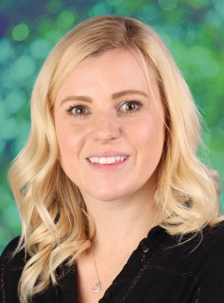
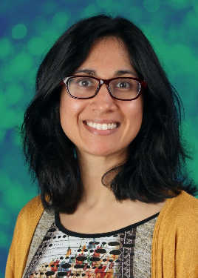
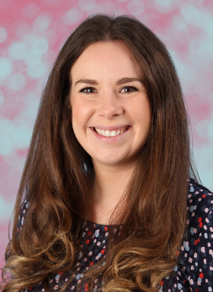
MONKEY PUZZLE CLASS TEACHER
Mrs Cranfield
SEQUOIA CLASS TEACHERS
Mrs Nakum
Mon - Wed
Mrs Howells
Thurs - Fri

Slide 3
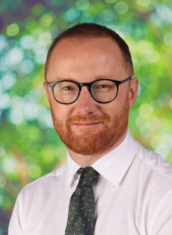
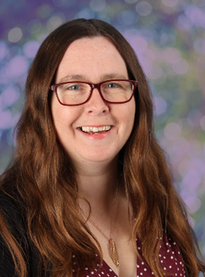
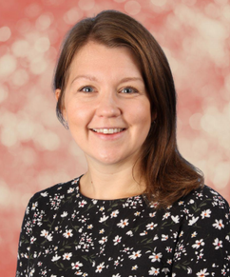
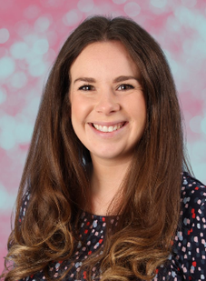
SAFEGUARDING TEAM:
Mr Crawley
Mrs Cork
Mrs Brennen
Mrs Howells

Slide 4
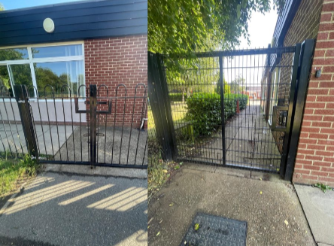
DROP OFF & PICK UP
  Arrival: 8:45am (gates close at 8:55am)
  Departure: 3:15pm
  Front junior gate (closest to the junior playground)
  It is really helpful if you try and stand in the same location at the end of each day so we can easily find you and send your child over. A wave is also very welcome!

Slide 5
UNIFORM
  Children should come to school wearing their P.E. kit on P.E. days but should wear their school uniform on all other days.
  Children should not wear jewellery other than stud earrings which must be removed for P.E. lessons. If a child is not able to remove their own stud earrings for P.E. then they should not wear them to school that day.
  Children should not wear make-up (including nail polish and hair dye) or transfer tattoos to school unless specifically stated for special events.
  Please see the school website for further details.

Slide 6
UNIFORM
  Hair must be worn tied up if shoulder length or longer.
  Children should wear plain black trainers or plain black school shoes for daily school life, including PE.
  Children should always come to school wearing appropriate clothing for the weather.
  Fitbits and analogue watches can be worn but please ensure there are no alarms set.
  No air tags or smart watches
  PLEASE MAKE SURE EVERYTHING IS NAMED!!

Slide 7
NATIONAL CURRICULUM
We adopt a theme-based approach to make the learning creative, fun and easier for the children to make links in their learning.
You can find out more about the curriculum content for each year group on our school website:
https://www.heathlands.essex.sch.uk/page/?title=Our+Learning&pid=8

Slide 8
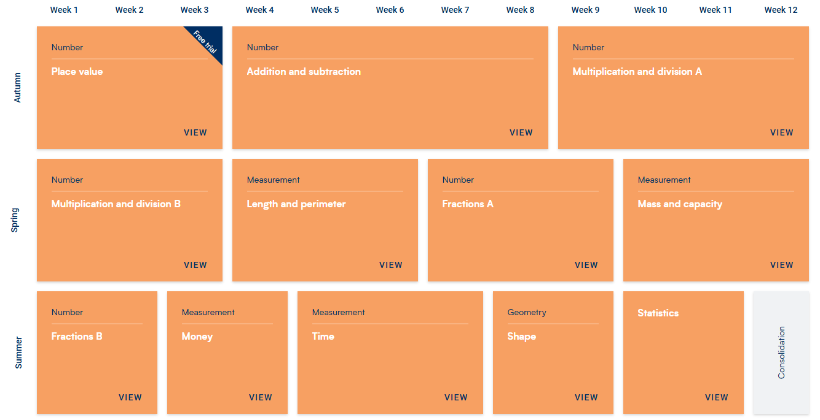
MATHS:

Slide 9
TIMES TABLES
In year 3, children consolidate their learning of times tables through daily practise. We focus on doubles, 2, 5, 10 multiplication and division facts, and begin learning squared numbers.
In maths, we investigate the 3, 4 and 8 times tables using arrays.
Children are encouraged to engage with Times Table Rockstars (TTRS) as often as possible at home (5 mins per day).

Slide 10
READING
  Children should read at least 5 times each week at home.
  5 - 10 minutes, every night.
  Ask questions about the story, for example, “Why do you think he did that?”.
  Children can bring in books from home that they’re enjoying reading if they wish.
  Children are encouraged to read a range of different genres and have fun exploring using expression.
  Weekly DERIC lessons: to explore different question types (decode, explain, retrieve, infer and choice)

Slide 11
OUR THEMES
Autumn – SpLENDIFEROUS sTORIES
Spring 1–Stone age rocks
Spring 2 –going GLOBAL
Summer 2– tomb raiders

Slide 12
TRIPS AND VISITORS
Autumn
- Local visit: St Mary’s Church
Spring
- Stone Age Visit (details to follow, cost approx. £20)
- Local visit: Village walk

Slide 13
HOME LEARNING
Reading – Regular reading to an adult at home, at least 5 times each week.
Spelling – We will send home some optional activities linked to the spelling of the tricky words and common exception words. There is no obligation to complete all of these, but any support you can provide with the learning of these words will be gratefully received.
Maths – We will send home a login for TTRS/Numbots and Purple Mash. Both of these websites have lots of fun activities for your child to complete.
Theme – There will be optional half termly learning challenges linked to the subjects we are teaching in school. These can be shared on Class Dojo.

Slide 14

RELATIONSHIPS AND BEHAVIOUR
Our Behaviour and Relationships Policy is based on this simple code of conduct where we promote ‘Being Safe, Being Kind, Being Respectful’ every day at Heathlands.

Slide 15

RELATIONSHIPS AND BEHAVIOUR
  Class marbles awarded for the class – this could be for anything from excellent lining up and great manners to a wonderful maths lesson or seeing brilliant teamwork.
  Any child who goes above and beyond in demonstrating our Core Values, embracing our Visible Learning ethos, or consistently making the right choices can be awarded a Celebration Certificate by any adult in school, at any time. These certificates will be displayed in classrooms and sent home at the end of each week.

Slide 16
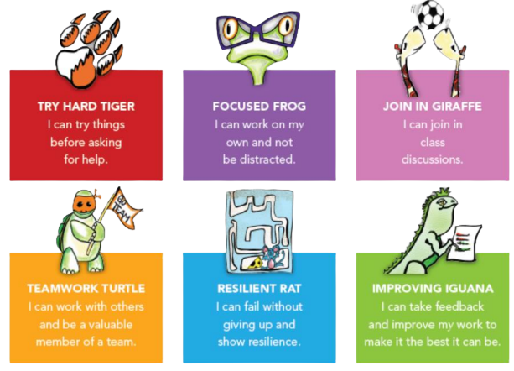
VISIBLE LEARNING

Slide 17
DAILY LIFE IN YEAR 3
  Rucksack every day with reading books and equipment.
  Please name all clothes.
  Suitable clothes for outdoors: coat, gloves, sunhat, named sun cream, etc.
  A named water bottle
  Please ensure children come to school in PE kit on PE days (these will be shared each term) – this may be outside so please ensure they have enough layers to keep warm!
  Snacks: We are a healthy school and we encourage all children to have a healthy, nut-free snack for playtime.
  Tasty Tuck: Twice a week (Tue and Fri). 60p for 1 item, or £1 for a drink and a snack.
  Children do not need to bring any toys or fidgets in from home, unless a teacher has agreed it with the parent.
  SHOW AND TELL - If your child has some learning they have done at home or anything related to the topic we would be more than happy to see it!

Slide 18








PENCIL CASES
No red book bag. Rucksack instead.
Children can bring in a pencil case with the following: a white board pen, pencil, black biro, purple biro, ruler, pritt stick, writing pencil, sharpener, eraser, and coloured pencils and/or felt tip pens. It is helpful if items are named.
- No retractable pens or heavy rubbers on top of pens.

Slide 19
MAKING CONTACT
  Class Dojo – we will use Class Dojo for communication. Teachers will check and reply to messages between the hours of 8:00am and 5:00pm only. However, as teachers are teaching during the day they may not see messages immediately.
  Alternatively, please make an appointment with the school office and we will try to speak to you as soon as possible or catch us on the gate.
  Should you need to contact the school office please use: admin@heathlands.essex.sch.uk
  If your child is going home with someone other than you, please let us know (in person or via the office). If this is a regular arrangement please let the office know, so they can amend the pick-up sheet.
  If your child is absent for any medical reason, please let the office know as the first port of call.
  All forms of communication between home and school should be in line with our core values of trust, respect, enjoyment, courage and kindness.
  Please do not put personal notes in your child’s reading diary as other adults may see this and we do not check the diaries every day.

Slide 20
DATES FOR YOUR DIARY
  Parent consultations:
    20ᵗʰ and 22ⁿᵈ October 2026
    9ᵗʰ and 11ᵗʰ February 2027
  Harvest Service: 28ᵗʰ September 2026
  Fireworks: 7ᵗʰ November 2026
  Christmas Service: 1ˢᵗ December 2026
  Easter Service: 24ᵗʰ March 2027
  Sports Day: 16ᵗʰ June 2027

