Slide 1



WELCOME TO YEAR 2
Helping Everyone Shine Their Light

Slide 2
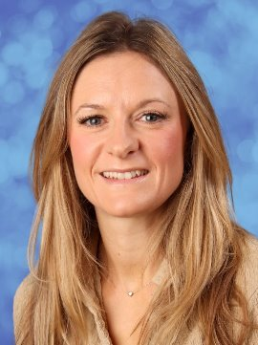
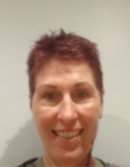
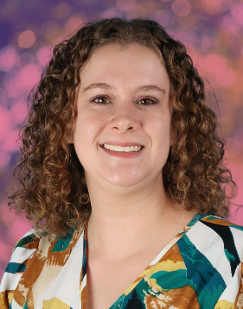
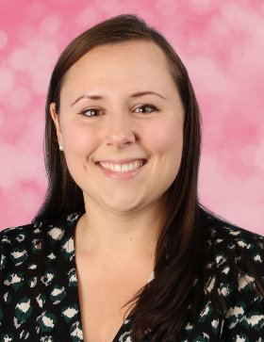
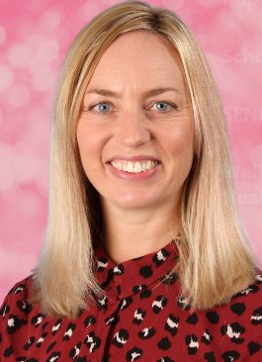
OLIVE CLASS TEACHERS
Mrs Fisher
Mon-Tues
Ms Hinds
Weds-Fri
Maternity Cover
1.9.26 - 23.10.26
Mrs Gidden
Weds-Fri
Returning 4.11.26
BANYAN CLASS TEACHERS
Mrs Frances
Mon - Weds
Mrs Patterson
Thurs - Fri

Slide 3
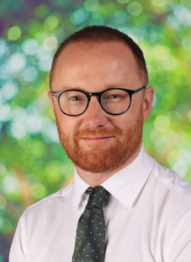
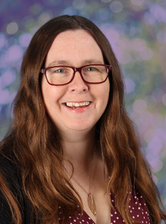
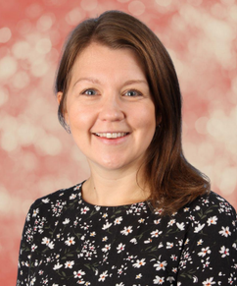
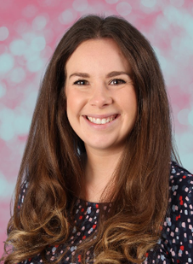
SAFEGUARDING TEAM:
Mr Crawley
Mrs Cork
Mrs Brennen
Mrs Howells

Slide 4
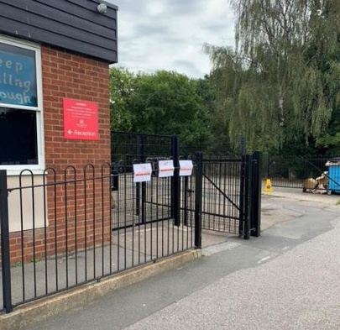
DROP OFF & PICK UP
  Arrival: 8:45am (gates close at 8:55am)
  Departure: 3:15pm
  Front infant gate (closest to the car park)
  All four KS1 classes use this gate.
  It is really helpful if you try and stand in the same location at the end of each day so we can easily find you and send your child over. A wave is also very welcomed!

Slide 5
UNIFORM
  Children should come to school wearing their P.E. kit on P.E. days but should wear their school uniform on all other days.
  Children should not wear jewellery other than stud earrings which must be removed for P.E. lessons. If a child is not able to remove their own stud earrings for P.E. then they should not wear them to school that day.
  Children should not wear make-up (including nail polish and hair dye) or transfer tattoos to school unless specifically stated for special events.
  Please see the school website for further details.

Slide 6
UNIFORM
  Hair must be worn tied up if shoulder length or longer.
  Children should wear plain black trainers or plain black school shoes for daily school life, including PE.
  Children should always come to school wearing appropriate clothing for the weather.
  Fitbits / other watches can be worn but please ensure there are no alarms set.
  Year 2 children should have a bookbag in school – we do not have the space to store backpacks in our classrooms or cloakrooms.
  PLEASE MAKE SURE EVERYTHING IS NAMED!

Slide 7
CONTINUING THE LEARNING JOURNEY FROM FOUNDATION TO KEY STAGE 1
In Year 2, we will continue to use a continuous provision approach at the beginning of the academic year. Towards the end of the academic year, we will move to a more formal approach to learning; where the children will all complete a task at the same time.
Continuous Provision: The children will learn through play alongside adult led activities in groups.
Children will continue to learn through practical, first-hand experiences - exploring and applying their learning.

Slide 8
NATIONAL CURRICULUM
We adopt a theme-based approach to make the learning creative, fun and easier for the children to make links in their learning.
You can find out more about the curriculum content for each year group on our school website:
https://www.heathlands.essex.sch.uk/page/?title=Our+Learning&pid=8

Slide 9
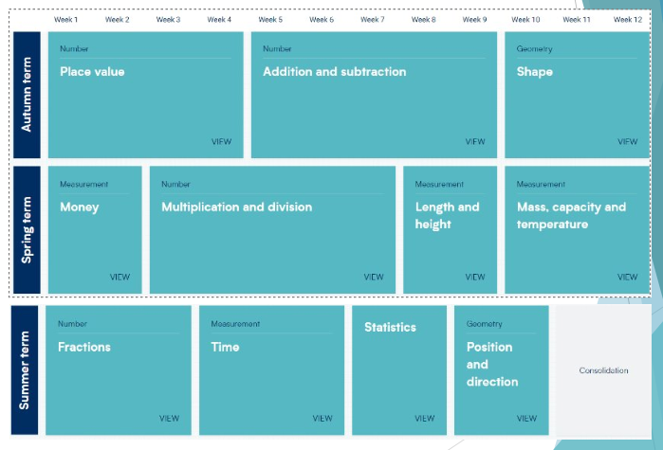
MATHS OVERVIEW:

Slide 10
PHONICS
  Using the foundations laid out during their time in EYFS and Year 1, we will continue to develop their knowledge of the different graphemes used for each sound within the English language through daily phonics lessons. We will also start to explore spellings patterns and rules.
  At the end of the year, some Year 2 children will take part in a national phonics screening check, if they didn’t meet the threshold for the screening check in Year 1. This will take place during the week beginning Monday 14th June 2027 and we will provide more details nearer the time.

Slide 11
READING
Reading book – sent home on a Monday
This follows our coloured band system. Focused on children being able to recognise sounds and build up fluency and prosody. Please encourage your child to read their books a number of times to ensure they grasp a solid understanding of the story as well as word recognition. Question them throughout! The expectation is to read 5 times a week.
Some children may become a ‘free reader’ during their time in Year 2. This means they are free to choose any book.
Sharing Book – sent home on a Monday
This book will be mostly decodable but is a book to be enjoyed together.
Library Book
Pupils will have the opportunity to visit the library and choose a book of their choice- it could be an interest, hobby etc.

Slide 12
READING
  Children should read at least 5 times each week at home.
  5 - 10 minutes, every night.
  Ask questions about the story, for example, “Why do you think he did that?”.
  Please use both sides of the reading diary to record reading at home.
  Please date and sign your child's reading diary, along with the title of the book every time you hear them read. You can record any other books your child is reading at home in their reading diary.
  A school adult will also hear your child read in school at least once a week and we will write in the diary when this has happened.

Slide 13
OUR THEMES
Autumn Term 1- 'Tall Tales’ (Literacy focus) ​
Autumn Term 2- 'This is Your Captain Speaking’ (History focus)​
Spring Term- 'Extreme Explorers’ (Geography focus)​
Summer Term- ‘Habitat Heroes’ (Science focus)

Slide 14
TRIPS AND VISITORS
Autumn: ​
Visitor: Tim West - a drama & literacy workshop. ​
Trip: Trip to the church to explore how they prepare for Christmas.​
​
Summer:​
Trip: 'Habitats' Trip (Cost Approx £20)​
Local Trip: Hillhouse woods.

Slide 15
HOME LEARNING
Reading – Regular reading to an adult at home, at least 5 times each week, using a circled H to show a ‘home read’ in diaries
Spelling – We will send home some half termly spellings to practice at home. These will be tested in the last week of each half term.
Maths – We will send home a login for Numbots and Purple Mash in reading diaries. Both of these websites have lots of fun activities for your child to complete.
Theme – There may be the occasional project for children to complete to help enrich our theme and learning in school.

Slide 16

RELATIONSHIPS AND BEHAVIOUR
Our Behaviour and Relationships Policy is based on this simple code of conduct where we promote ‘Being Safe, Being Kind, Being Respectful’ every day at Heathlands.

Slide 17

RELATIONSHIPS AND BEHAVIOUR
  Class marbles awarded for the class – this could be for anything from excellent lining up and great manners to a wonderful maths lesson or seeing brilliant teamwork.
  Any child who goes above and beyond in demonstrating our Core Values, embracing our Visible Learning ethos, or consistently making the right choices can be awarded a Celebration Certificate by any adult in school, at any time. These certificates will be displayed in classrooms and sent home at the end of each week.

Slide 18
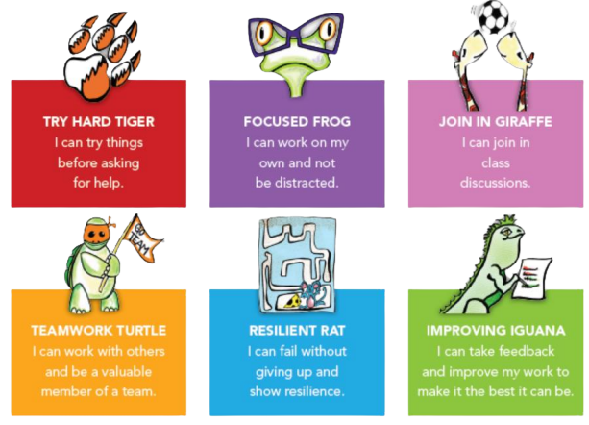
VISIBLE LEARNING

Slide 19
DAILY LIFE IN YEAR 2
  Book bag every day with reading books and reading diary.
  Please name all clothes.
  Suitable clothes for outdoors: coat, gloves, sunhat, named sun cream, etc.
  A named water bottle
  Please ensure children come to school in PE kit on PE days (these will be shared each term) – this may be outside so please ensure they have enough layers to keep warm!
  Snacks: We are a healthy school and in EYFS and KS1 the children are all provided with a piece of fruit for their breaktime snack. We encourage all children to have this but understand that some children may not like what’s on offer. As a result, they can bring in their own snack but please ensure it is healthy and nut free.
  Where appropriate, please encourage your children to leave their
  own toys at home.
  SHOW AND TELL - If your child has some learning they have done at home or anything related to the topic we would be more than happy to see it!

Slide 20
MAKING CONTACT
  Class Dojo – we will use Class Dojo for communication. Teachers will check and reply to messages between the hours of 8:00am and 5:00pm only. However, as teachers are teaching during the day, they may not see messages immediately.
  Alternatively, please make an appointment with the school office and we will try to speak to you as soon as possible or catch us on the gate.
  Should you need to contact the school office please use: admin@heathlands.essex.sch.uk
  If your child is going home with someone other than you, please let us know (in person or via the office). If this is a regular arrangement please let the office know, so they can amend the pick-up sheet.
  If your child is absent for any medical reason, please let the office know as the first port of call.
  All forms of communication between home and school should be in line with our core values of trust, respect, enjoyment, courage and kindness.
  Please do not put personal notes in your child’s reading diary as other adults may see this and we do not check the diaries every day.

Slide 21
DATES FOR YOUR DIARY
  Parent consultations:
    20ᵗʰ and 22ⁿᵈ October 2026
    9ᵗʰ and 11ᵗʰ February 2027
  Harvest Service: 28ᵗʰ September 2026
  Fireworks: 7ᵗʰ November 2026
  Christmas Service: 1ˢᵗ December 2026
  Easter Service: 24ᵗʰ March 2027
  Sports Day: 16ᵗʰ June 2027

