Slide 1
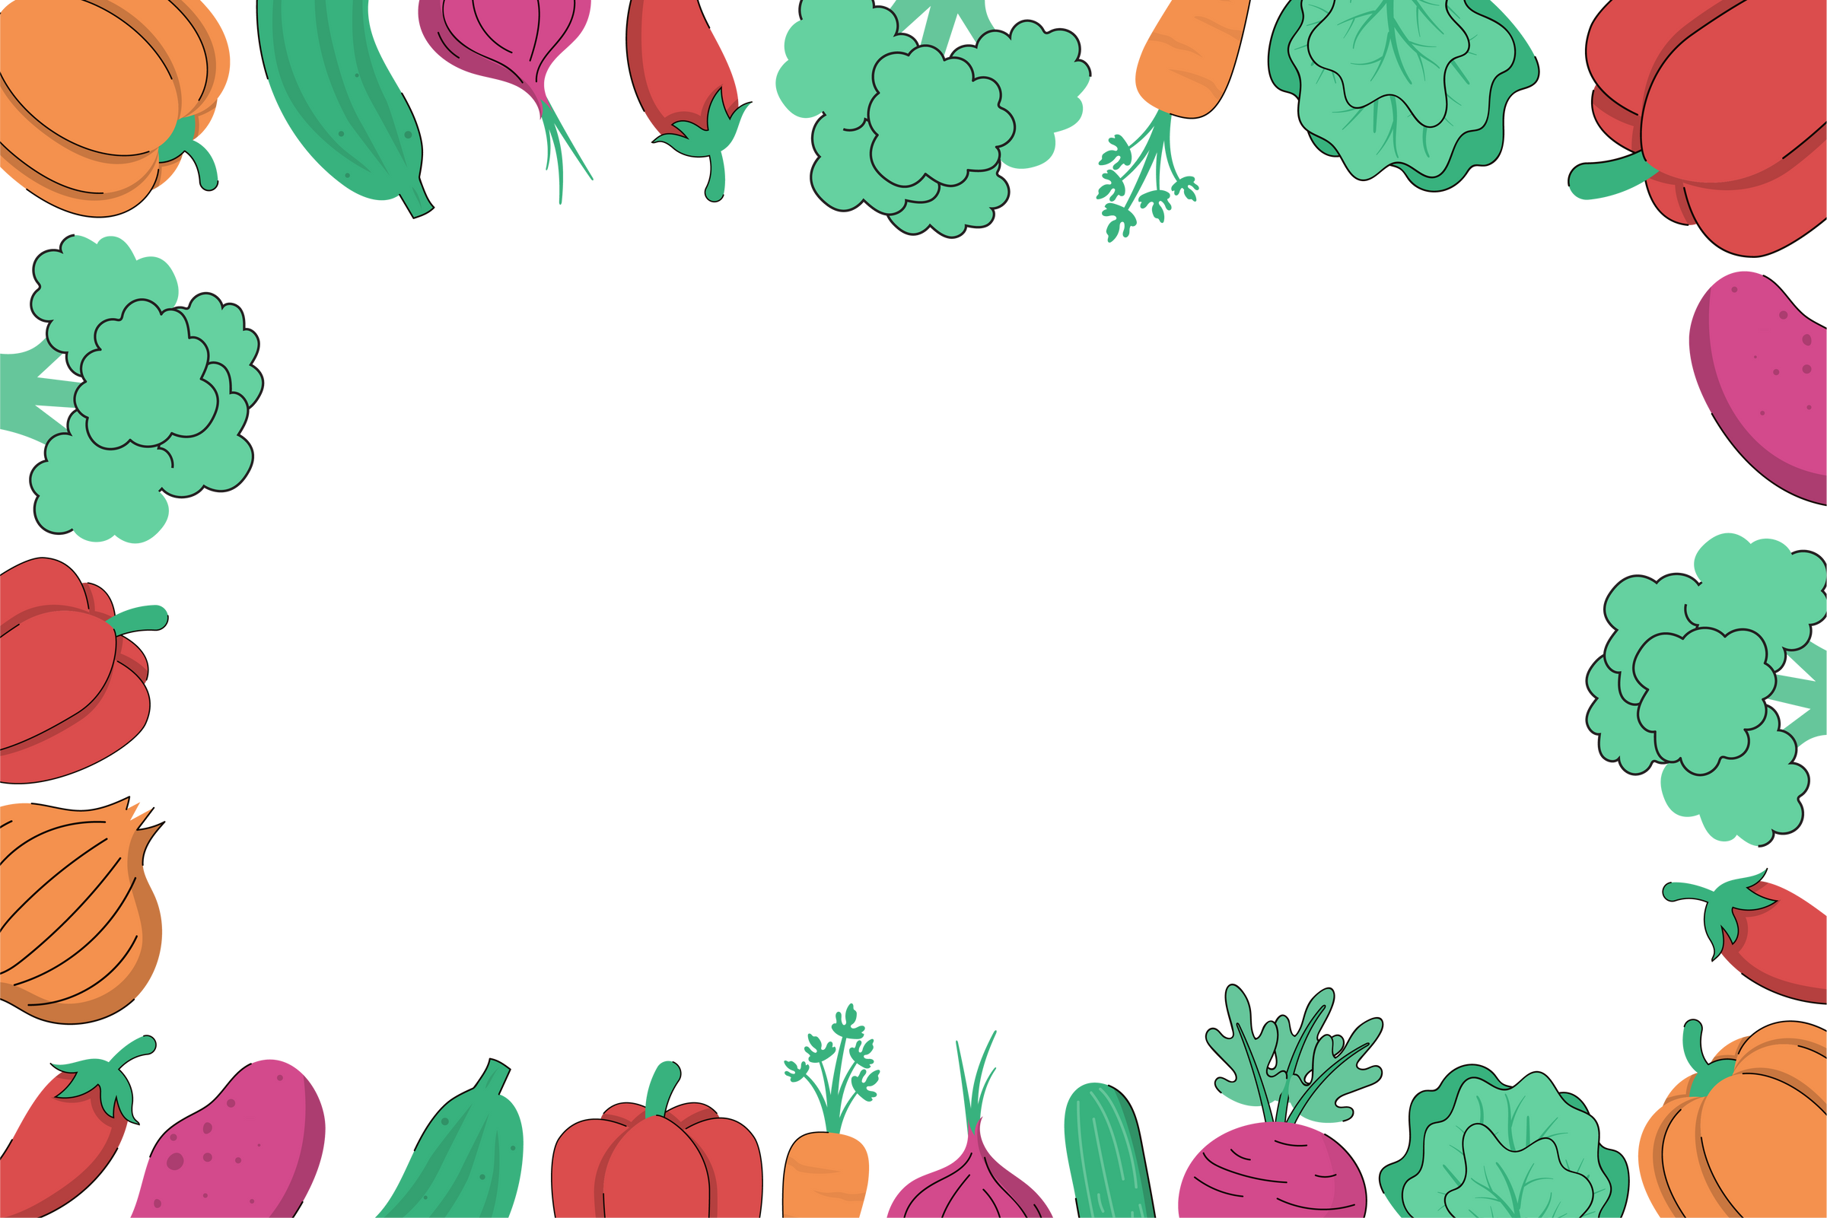

Heathlands Menu
FRESH SALAD BAR DAILY
 | Monday | Tuesday | Wednesday | Thursday | Friday
Week 1 WC 01.09.26 21.09.26 12.10.26 01.11.26 30.11.2604.01.27 25.01.27 22.02.27 15.03.27 | Jacket Potato with tuna (fish, egg), cheese (milk), beans, or chili beef Vegetable Pesto Pasta (nut free, vegan, gluten) | Savory mince, mash and vegetables (dairy free) or Grab & go station: Ham, tuna (fish, egg) or cheese (milk) roll (gluten) with a juice box, cookie (gluten), Pom Bears | Roast Chicken or Vegan Quorn fillet (gluten) Served with Yorkshire pudding (gluten, egg, milk) roast potatoes, seasonal vegetables and gravy Jacket Potato with tuna (fish, egg), cheese (milk), beans, | All Day Breakfast Bacon, Sausage, egg, hashbrown and beans or Jacket Potato with tuna (fish, egg), cheese (milk), beans, | Chicken Nuggets (gluten) Vegan Nuggets (gluten) Served with chips and sweetcorn
Dessert | Chocolate Mousse (milk) or Yoghurt (milk) or Fresh fruit Allergy friendly cookies available | Apple crumble and custard (soya, egg, milk, gluten) or Jelly or Fresh fruit Allergy friendly cookies available | Artic roll (milk, gluten, eggs, soya) or Fresh fruit Allergy friendly cookies available | Cornflake cake (gluten) or Jelly or Fresh fruit Allergy friendly cookies available | Shortbread biscuit (gluten) or Yoghurt (Milk) or Fresh fruit Allergy friendly cookies available
Allergy Friendly options available
Allergens are highlighted in red

Slide 2
Heathlands Menu
FRESH SALAD BAR DAILY
 | Monday | Tuesday | Wednesday | Thursday | Friday
Week 2 07.09.26 28.09.26 19.10.26 16.11.26 07.12.26 11.01.27 01.02.27 01.03.27 | Cheese and Tomato Pasta Bake (gluten, milk) Served with seasonal vegetables or Jacket Potato with tuna (fish, egg), cheese (milk), beans, or chili beef | Crispy chicken burger (gluten) or Vegetable burger (gluten) Served with potato bites and sweetcorn Jacket Potato with tuna (fish, egg), cheese (milk), beans, or chili beef | Roast Gammon or Vegan Quorn fillet with Yorkshire pudding (Gluten, Egg, Milk), roast potatoes, seasonal vegetables and gravy Or Jacket Potato with tuna (fish, egg), cheese (milk), beans, or chili beef | Spaghetti bolognaise served with garlic bread (gluten) Vegan spaghetti bolognaise (gluten) or Grab & go station: Ham, tuna (fish, egg) or cheese (milk) roll (gluten) with a juice box, cookie (gluten), Pom Bears | Sausage, chips and beans (gluten, sulphites) Vegan Nuggets, chips and beans (gluten)
Dessert | Pancakes and chocolate sauce (gluten, egg, milk) or Jelly or Fresh fruit Allergy friendly cookies available | Autumn spice cake (egg, soya, milk, gluten) or Jelly or Fresh fruit Allergy friendly cookies available | Artic roll (milk, gluten, eggs, soya) or Yoghurt (milk) or Fresh fruit Allergy friendly cookies available | Chocolate rice crispy cake (diary free, gluten) or Jelly or Fresh fruit Allergy friendly cookies available | Shortbread biscuit (dairy free, gluten) or Fresh fruit Allergy friendly cookies available
Allergy Friendly options available
Allergens are highlighted in red

Slide 3
Heathlands Menu
FRESH SALAD BAR DAILY
 | Monday | Tuesday | Wednesday | Thursday | Friday
Week 3 14.09.26 05.10.26 02.11.26 23.11.26 14.12.26 18.01.27 08.02.2708.03.27 | Pepperoni pizza (gluten, milk) Cheese & Tomato pizza (gluten, milk) Served with seasonal vegetables and garlic bread (gluten, milk) Served with seasonal vegetables or Jacket Potato with tuna (fish, egg), cheese (milk), beans, | Beef Lasagne (gluten, milk) Vegetable Lasagne (gluten, milk) Served with Garlic Bread (gluten) and seasonal vegetables or Jacket Potato with tuna (fish, egg), cheese (milk), beans, | Roast Chicken or Vegan Quorn fillet with Yorkshire pudding (gluten, egg, milk), roast potatoes, seasonal vegetables and gravy Or Jacket Potato with tuna (fish, egg), cheese (milk), beans, | Sausage and Mash (Sulphites, gluten, dairy free) Vegetarian sausage and mash (gluten, dairy free) Served with seasonal vegetables or Grab & go station: Ham, tuna (fish, egg) or cheese (milk) roll (gluten) with a juice box, cookie (gluten), Pom Bears | Fish fingers (fish, gluten) with chips and peas Vegan Nuggets (gluten) with chips and peas
Dessert | School cake (milk, egg, gluten) or Jelly or Fresh fruit Allergy friendly cookies available | Cherry sponge (milk gluten, soya, egg) or Yoghurt (milk) or Fresh fruit Allergy friendly cookies available | Artic roll (milk, gluten, eggs, soya) or Jelly or Fresh fruit Allergy friendly cookies available | Chocolate pudding and chocolate custard (egg, soya, milk, gluten) or Jelly or Fresh fruit Allergy friendly cookies available | Shortbread biscuits (gluten, dairy free) or Jelly or Fresh fruit Allergy friendly cookies available
Allergy Friendly options available

